Slide 1

TOPIC : an analytical study on retailing activities
Performed by shree Shivam attires
Pvt. Ltd nagpur
SUBMITTED BY : bhumika Harish khare
Course : Bachelor of Vocational –retail management
Year : 3th Year (6 sem)
Session : 2023-2024

Slide 2
Index
Introduction
Objectives
Unique Collection
Data Collection
Bibliography
Reference
Conclusion

Slide 3
Introduction
Shree Shivam Attires PVT LTD are one of India's leading multi- brand clothing store outlets keeping a wide range of exclusive Designer Wedding Wear collections, stylish Ethnic & Western Clothes. Present across 6 cities in India and growing our Stores are stand-alone fashion destinations for those looking to announce their presence.Sri Shivam is humanitarian, contemporary thinker on leadership, visionary and a self-transformation coach.

Slide 4
objectives
To study retailing activity of Shree Shivam.
To study inventory management of Shree Shivam.
To study staffing process of Shree Shivam.

Slide 5
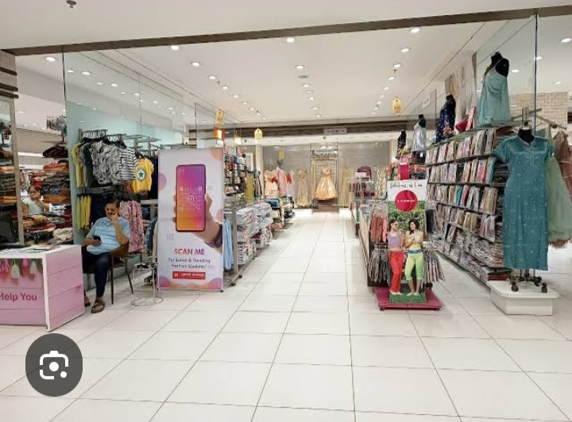
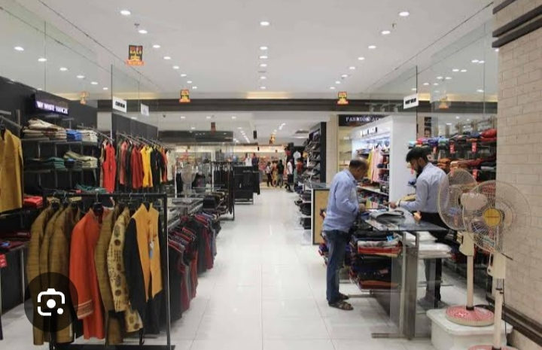
UNIQUE COLLECTION

Slide 6
DATA COLLECTION
PRIMARY DATA
SECONDARY DATA1.
PRIMARY DATA: process of gathering data throughsurveys, interview, of experiment. A typical example of primary data is household surveys.
SECONDARY DATA: secondary data is data collected by someone other than the actual user. It means that's the information is already available, and someone analyses it. The secondary Data includes Magazine, Newspaper, books, journals, etc. it may be either published data or unpublished data.

Slide 7
Bibliography
For successfully completing my project fild. I have taken help from following
https://www.shreeshivam.com
Books
Retail management
Problems and prospects

Slide 8
Reference
Problem and prospects of Indian retailing
Reengineering Retail
Resurrecting Retail

Slide 9
conclusion
To be the preferred and trusted resource for the products and services that enhance home and family life.
Shree Shivam Services Pvt Ltd expects that all of its business is conducted in compliance with high ethical standards of business practice. We apply these standards to all dealings with employees, customers, suppliers and other stakeholders

Slide 10
Thank you

